Slide 1
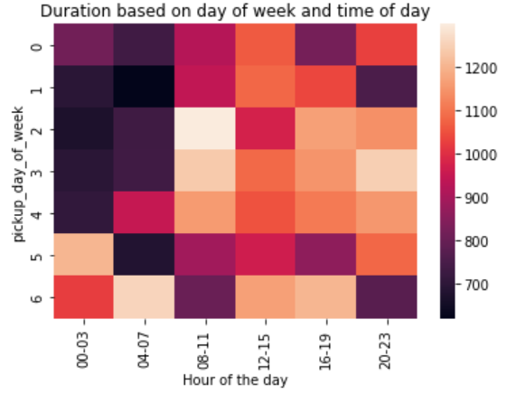
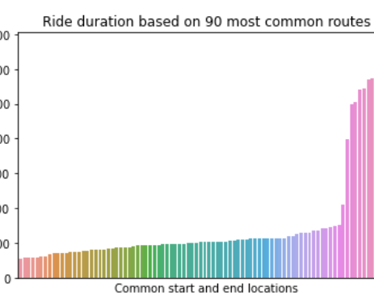
New York City Taxi and Limousine Commission
Ride Duration Prediction Model
This project is aimed at developing a regression model that predicts taxi and limousine ride durations based on location and time of day data that the New York City Taxi and Limousine Commission (TLC) has gathered.
We will build a regression model to predict the duration of taxi and limousine rides.
We expect to have the model accurately predict the ride duration down to +/- 3 minutes on average.
We will keep working until we reach this benchmark
This will give better allocation of drivers at certain times of day. Customers and drivers will be more satisfied with lower wait times. Prices can be optimized.
We believe traffic will be a key factor for predicting the ride duration. (See top chart)
Also, we looked at common routes and found that some have longer durations than others. Also we have access to the distance between routes.
We also expect to find patterns to help predict from the vendor used and the payment method.

